Slide 1

Lexical Fuzzing
Computer Systems and Security Group (CSS Group) , USTC
www.csslab.io

Slide 2

Mutation-Based Fuzzing
Fuzzing a URL Parser
Many programs expect their inputs to come in a very specific format, for example, URL (a Web address).
When fuzzing with random inputs, what are our chances to actually produce a valid URL?
protocol (http,ftp,file)
path on the host (search)
marker for a location in the retrieved document, such as “#result”
name of the host
list of key/value pairs such as “q=fuzzing”

Slide 3
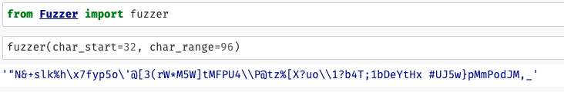
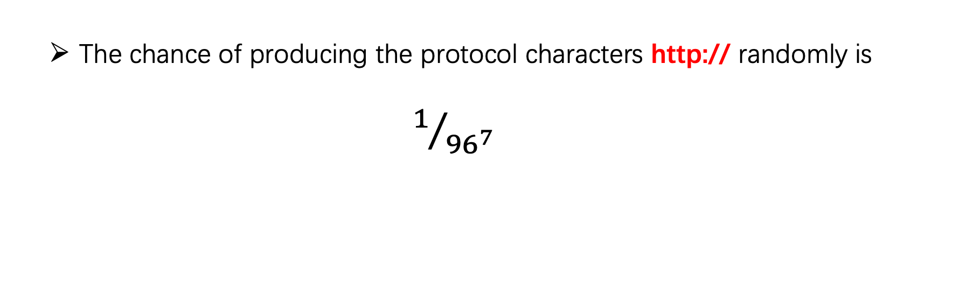
Mutation-Based Fuzzing
Fuzzing a URL Parser
What are the chances of actually getting a valid URL by using the
simple fuzzer() function?
The chance of producing the protocol characters http:// randomly is
$1/{{96}^{7}}$
fuzzing by generating random strings is too expensive here!

Slide 4
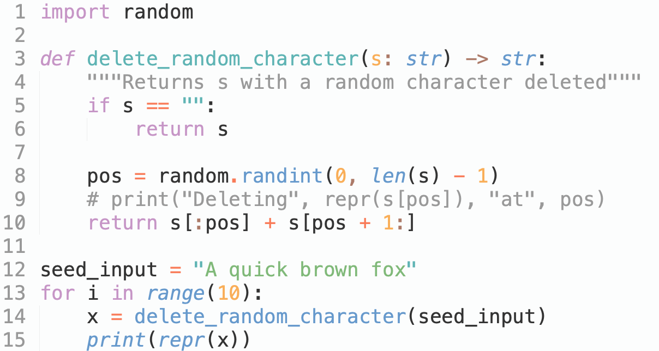
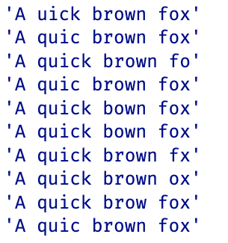
Mutation-Based Fuzzing
Mutating Inputs
The alternative to generating random strings from scratch is to start with a given valid input, and then to subsequently mutate it；
mutation: inserting a (random) character, deleting a character, or flipping a bit in a character representation.
delete mutator

Slide 5
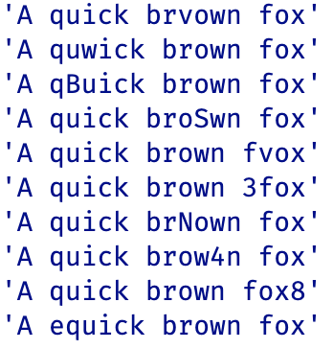
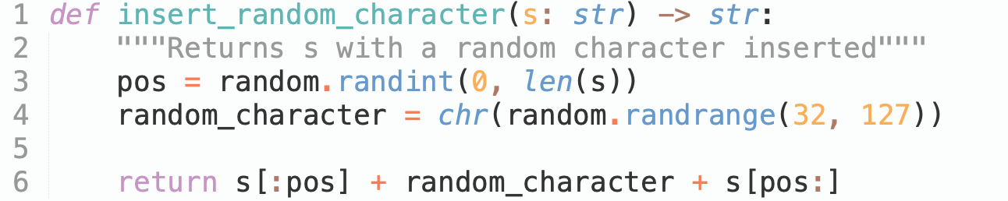
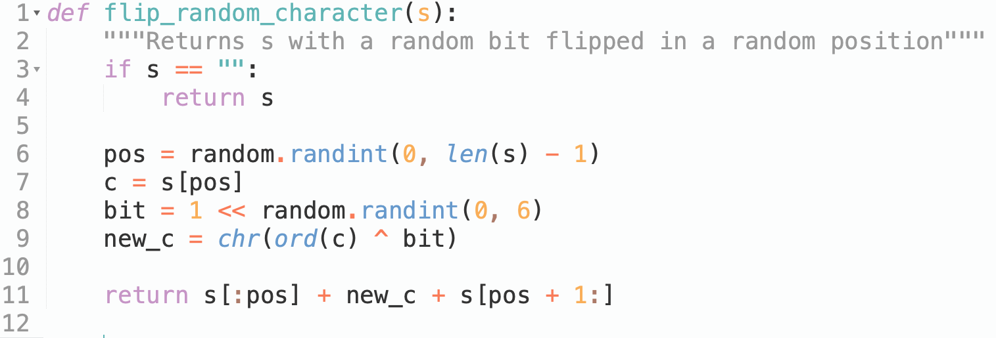
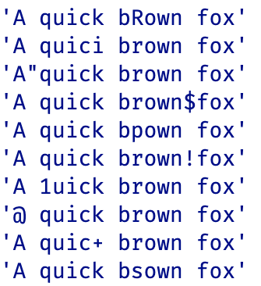
Mutation-Based Fuzzing
More Mutating
insert mutator
filp mutator

Slide 6
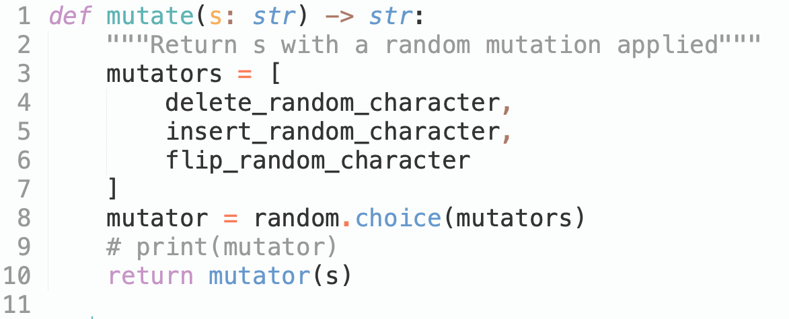
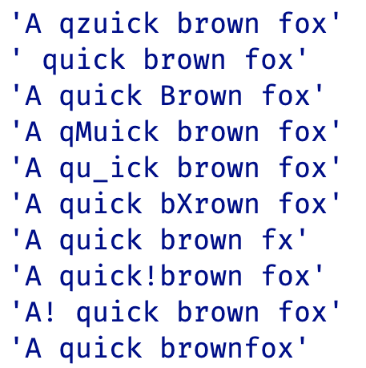
Mutation-Based Fuzzing
Random Select the Mutators

Slide 7
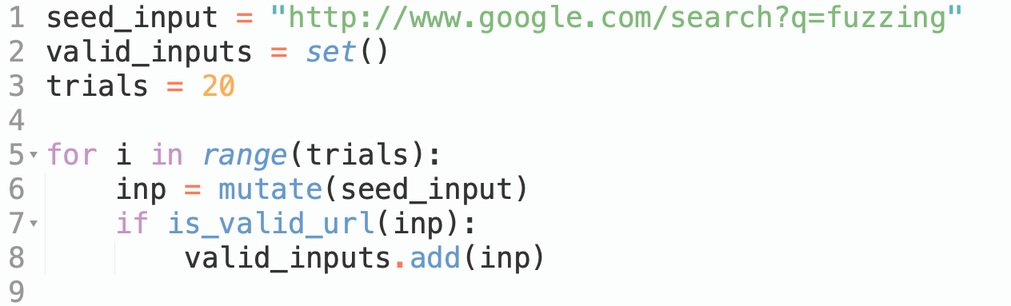
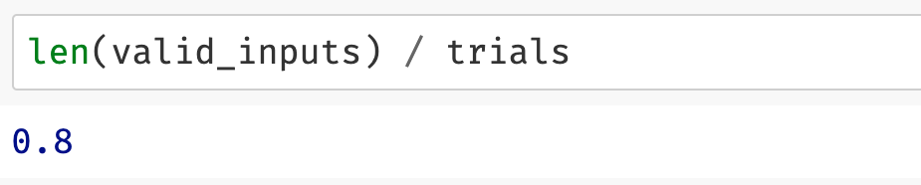
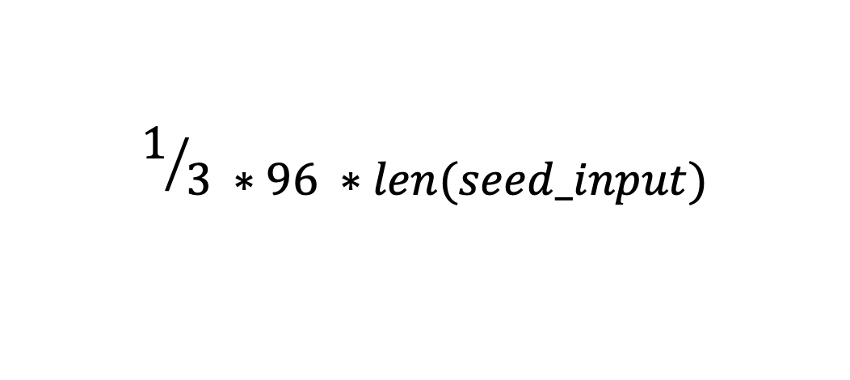
Mutation-Based Fuzzing
Mutating URLs
What the chance we mutate the http: to https: ?
$$1/{3 ∗96 ∗len(seed_input)}$$
What about ftp:?

Slide 8
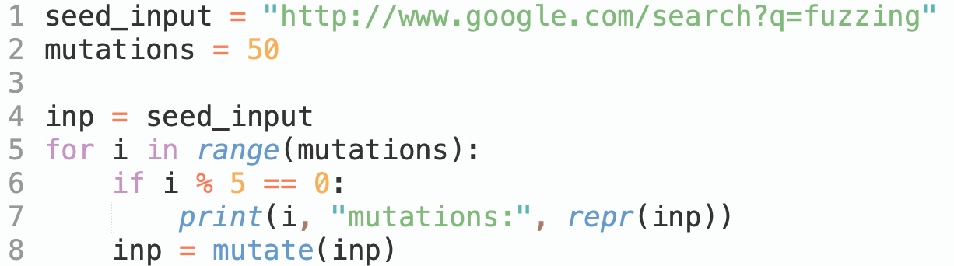
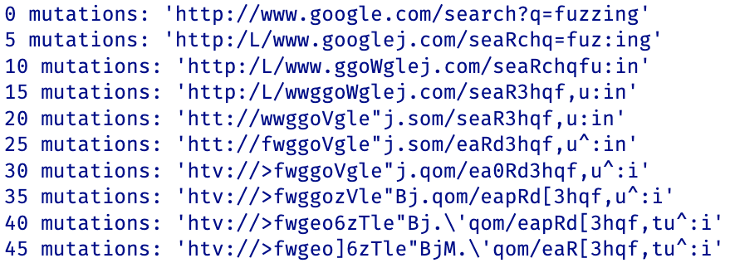
Mutation-Based Fuzzing
Multiple Mutations
By mutating the input again and again, we get a higher variety in the input.
also can select from a range randomly

Slide 9
Mutation-Based Fuzzing
Guiding by Coverage
How can we leverage coverage to guide test generation?
One particularly successful idea is implemented in the popular fuzzer named AFL（American fuzzy lop):

Slide 10
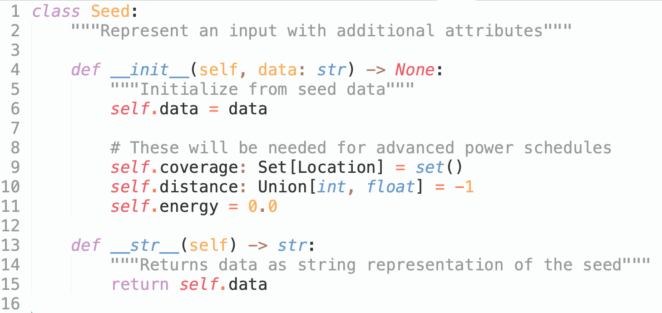
Greybox Fuzzing
Seeds and Power Schedules
Seed's Energy: the likelihood with which seed is chosen from the population

Slide 11
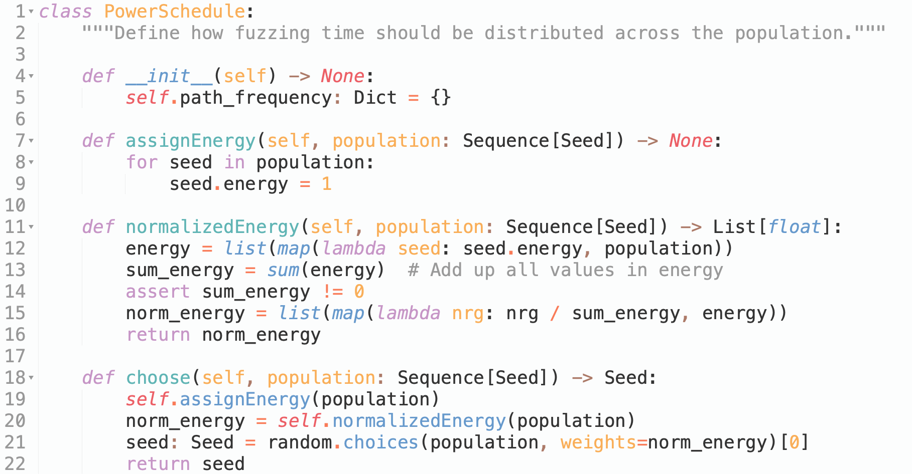
Greybox Fuzzing
Seeds and Power Schedules
Power Schedule: the procedure that decides a seed's energy
Assigns each seed the same energy
Normalize energy
Choose weighted by normalized energy

Slide 12
Greybox Fuzzing
Advanced Blackbox Mutation-based Fuzzing
Integrate both the mutator and power schedule into a fuzzer
Normalize energy
Choose weighted by normalized energy

Slide 13
Greybox Fuzzing
Seeds and Power Schedules
Power Schedule: the procedure that decides a seed's energy
AFL power schedule assigns more energy to seeds that are shorter, that execute faster, and yield coverage increases more often.

Slide 14

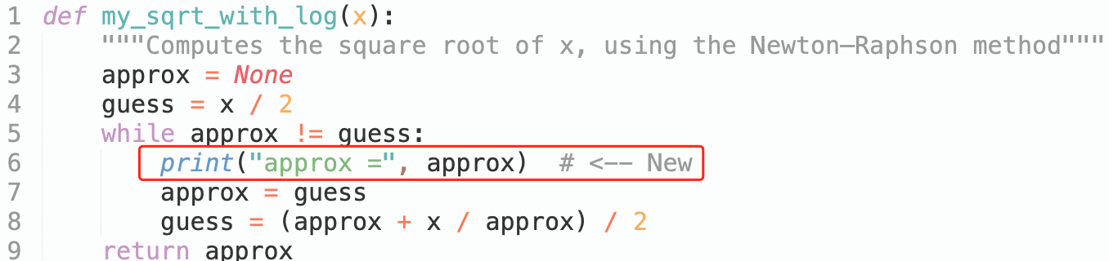
Introduction to Software Testing
Method 1: Run & Check Manually
Moreover，Debug the Function

Slide 15
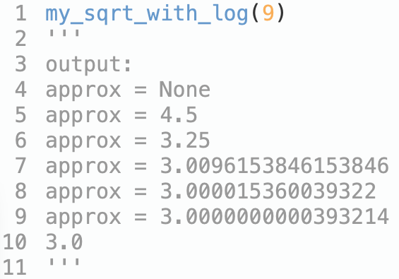
Introduction to Software Testing
Method 1: Run & Check Manually
Moreover，Debug the Function

Slide 16
Introduction to Software Testing
Method 1: Run & Check Manually
How to verify the results?

Slide 17
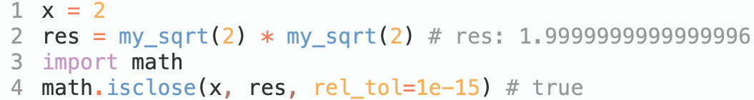
Introduction to Software Testing
Method 1: Run & Check Manually
How to verify the results?
Checking the Function

Slide 18
Introduction to Software Testing
Method 1: Run & Check Manually
Problems:
Can only check a very limited number of executions and their results
After any change to the program, you have to repeat the testing process

Slide 19
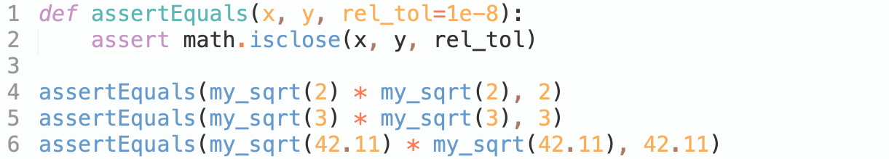
Introduction to Software Testing
Method 2: Automated Testing

Slide 20
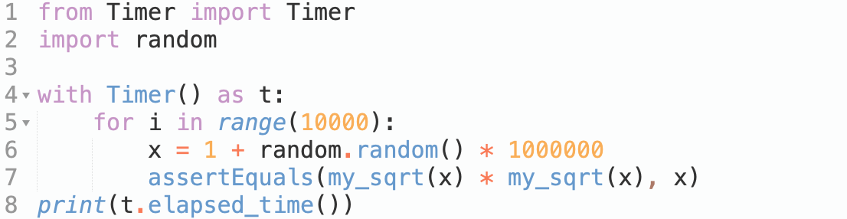
Introduction to Software Testing
Method 2: Automated Testing
With Loop, Random and Timer
Generate 100000 test cases
automatically and randomly!

Slide 21
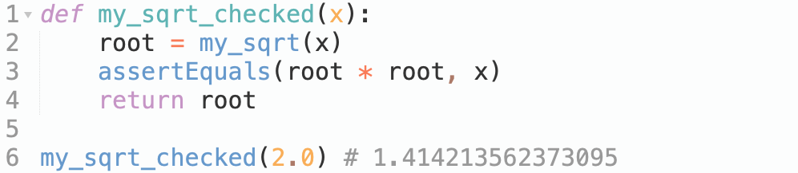
Introduction to Software Testing
Run-Time Verification

Slide 22
Introduction to Software Testing
Run-Time Verification

Slide 23
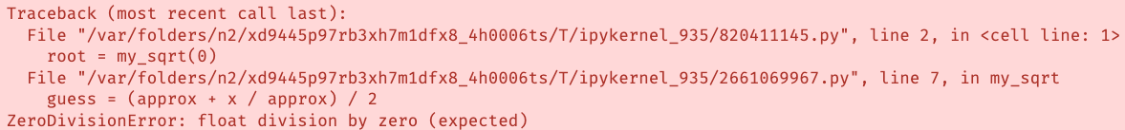
Introduction to Software Testing
The Limits of Testing
Incompleteness: there may always be untested inputs for which the function may still fail.
After any change to the program, you have to repeat the testing process

Slide 24

Fuzzing 101
The Origin of Fuzzing
Fuzzing was born on a“ dark and stormy night in the Fall of 1988”. Prof. Barton Miller, connected to his university computer via a 1200 baud line, noticed frequent crashes. As a scientist, he wanted to investigate the extent of the problem and its causes. So, he created a programming exercise for his students at UW-Madison to create the first fuzzer.
The Goal of the First Fuzzer
Evaluate UNIX utility programs' robustness with an unpredictable input stream
Build a fuzz generator to output random characters, then use it to attack multiple programs to try to break them.
Prof. Barton P Miller

Slide 25
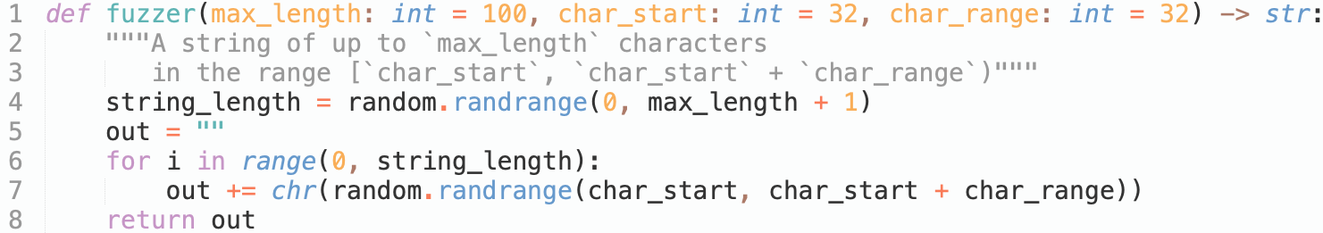
Fuzzing 101
A Simple Fuzzer
Randomly generate strings length which range is [0, 100]

Slide 26
Fuzzing 101
A Simple Fuzzer
Randomly generate characters in ASCII order [32, 64)

Slide 27
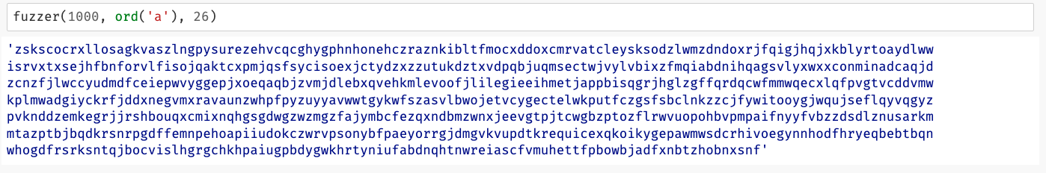
Fuzzing 101
A Simple Fuzzer

Slide 28
Fuzzing 101
A Simple Fuzzer
More Pythonic!

Slide 29
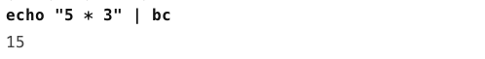
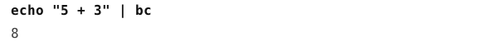
Fuzzing 101
Long-Running Fuzzing External Programs
How to fuzzing Linux tools bc using our simple fuzzer() ?

Slide 30
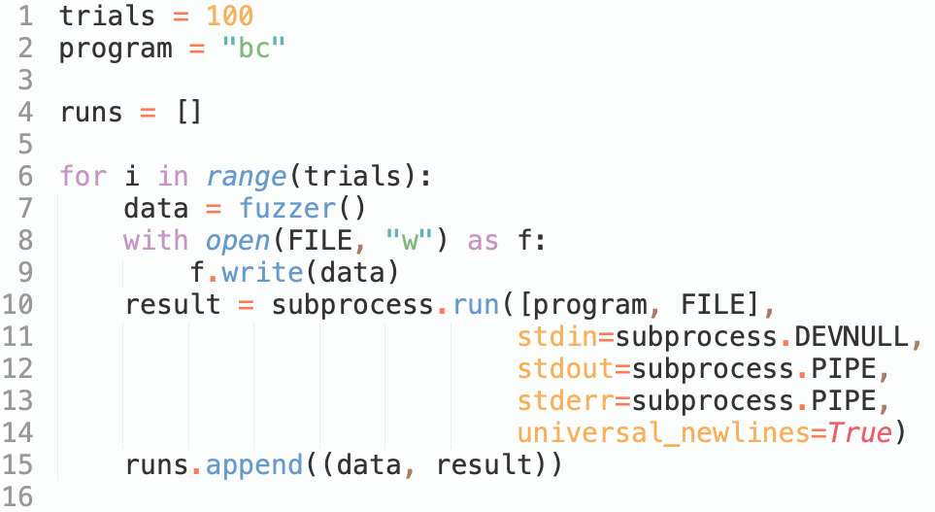
Fuzzing 101
Long-Running Fuzzing External Programs
How to fuzzing Linux tools bc using our simple fuzzer() ?
Number of test sets

Slide 31
Fuzzing 101
Long-Running Fuzzing External Programs
How to fuzzing Linux tools bc using our simple fuzzer() ?
Fuzzing target

Slide 32
Fuzzing 101
Long-Running Fuzzing External Programs
How to fuzzing Linux tools bc using our simple fuzzer() ?
Save fuzzing results

Slide 33
Fuzzing 101
Long-Running Fuzzing External Programs
How to fuzzing Linux tools bc using our simple fuzzer() ?
Generate test case by fuzzer()

Slide 34
Fuzzing 101
Long-Running Fuzzing External Programs
How to fuzzing Linux tools bc using our simple fuzzer() ?
Run target with test case in sub-process

Slide 35
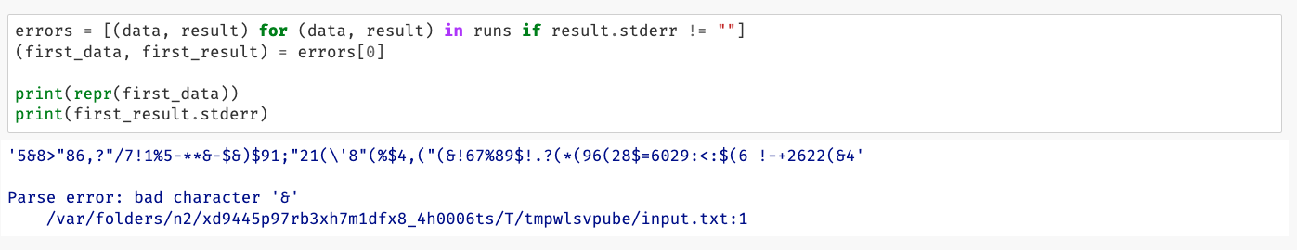
Fuzzing 101
Long-Running Fuzzing External Programs
Let us take a look at the first error message?

Slide 36
Fuzzing 101
Long-Running Fuzzing External Programs
Let us take a look at the first error message?
Are there any runs crashed (return code is not 0)?:

Slide 37
Bugs Fuzzers Find
The Goal of the First Fuzzer
Evaluate UNIX utility programs' robustness with an unpredictable input stream
Build a fuzz generator to output random characters, then use it to attack multiple programs to try to break them.
The Result of the First Fuzzer
When Miller and his students ran their first fuzzers in 1989, they found an alarming result: About a third of the UNIX utilities they fuzzed had issues – they crashed, hung, or otherwise failed when confronted with fuzzing input [1]
[1] Barton P. Miller, Lars Fredriksen, and Bryan So. 1990. An empirical study of the reliability of UNIX utilities. Commun. ACM 33, 12 (Dec. 1990), 32–44. https://doi.org/10.1145/96267.96279
Prof. Barton P Miller

Slide 38
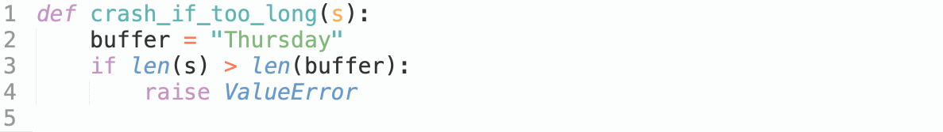
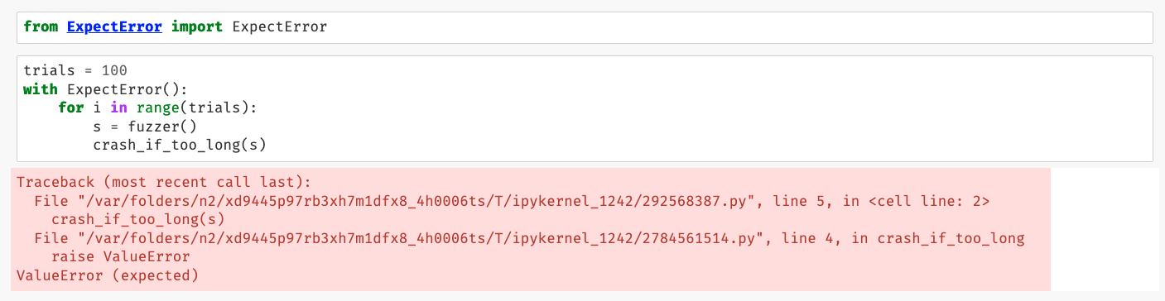
Bugs Fuzzers Find
Buffer Overflows
C
Python

Slide 39
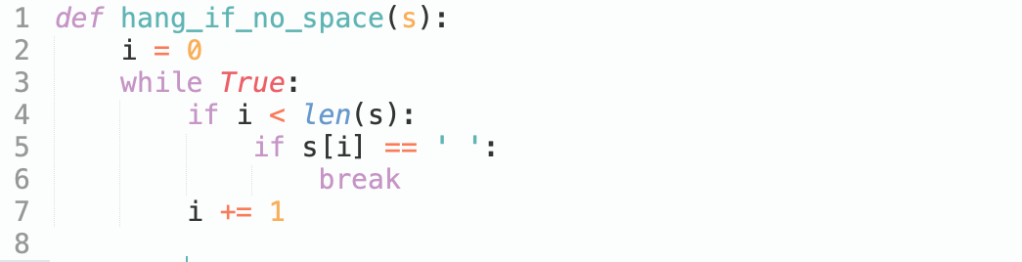
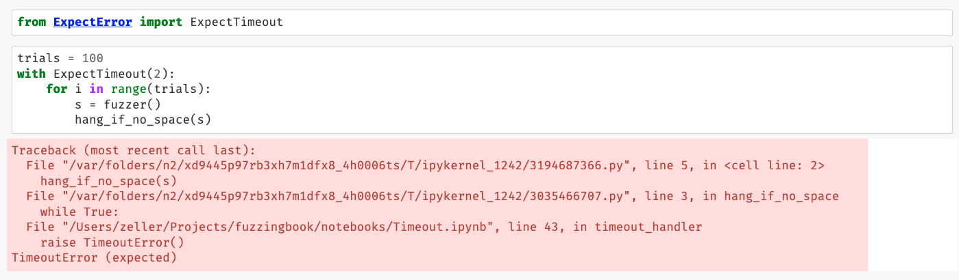
Bugs Fuzzers Find
Missing Error Checks
Some programming languages like C do not have exceptions
Python

Slide 40
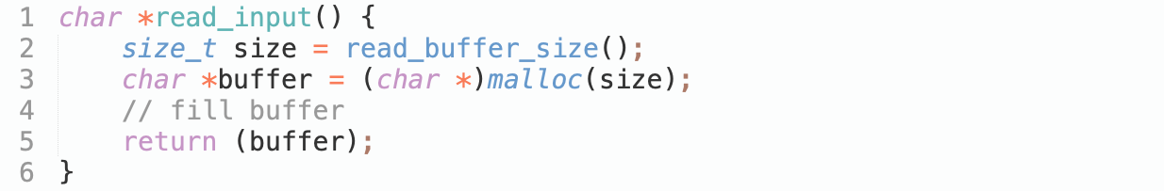
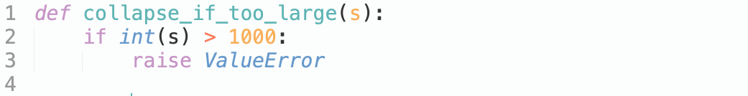
Bugs Fuzzers Find
Rogue Numbers
C
What happens if size is very large, exceeding program memory?
What happens if size is less than the number of characters following?
What happens if size is negative?
Python

Slide 41
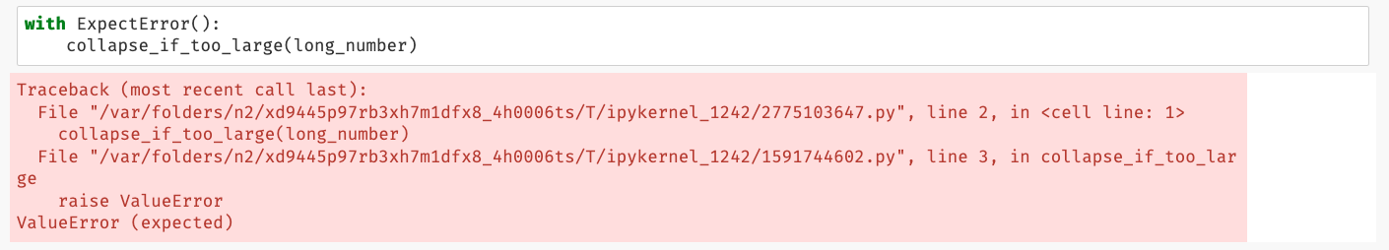
Bugs Fuzzers Find
Rogue Numbers
Python

Slide 42
Catching Errors
Generic Checkers

Slide 43
Catching Errors
Program-Specific Checkers

Slide 44
Catching Errors
Static Code Checkers

Slide 45
A Fuzzing Architecture

Slide 46
A Fuzzing Architecture

Slide 47
Code Coverage
How do we measure the effectiveness of these generated tests?
check the number of bugs found
code coverage: measuring which parts of a program are actually executed during a test run

Slide 48
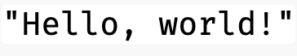
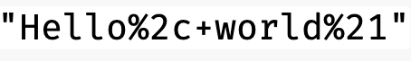
Code Coverage
A CGI Decoder
CGI encoding is used to encode characters to be invalid in a URL
CGI encode
Blanks are replaced by '+'

Slide 49
Code Coverage
A CGI Decoder
CGI encoding is used to encode characters to be invalid in a URL
CGI encode
Other invalid characters are replaced by“%xx”,
where xx is the two-digit hexadecimal equivalent

Slide 50
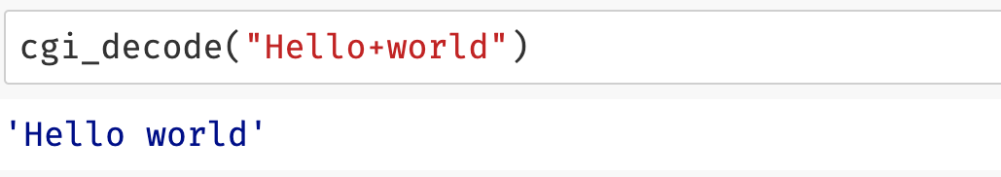
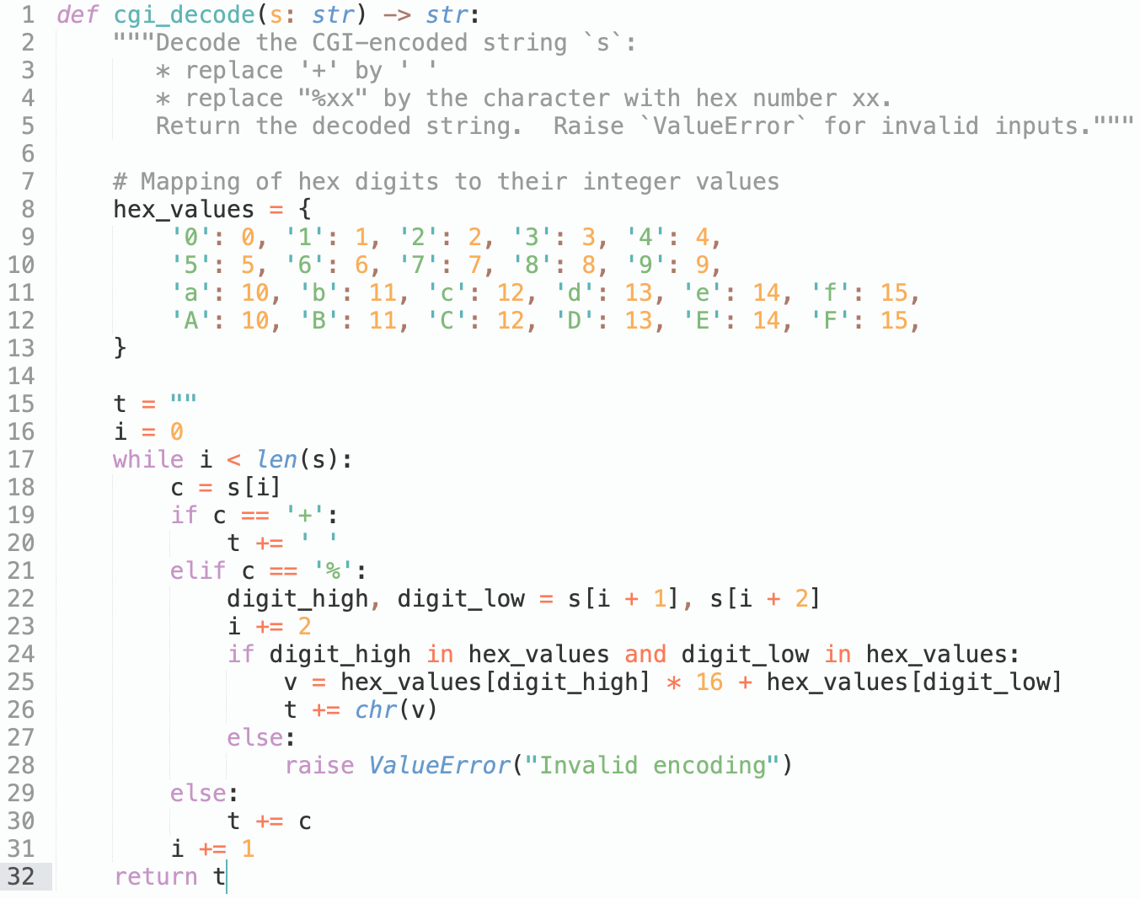
Code Coverage
The function cgi_decode() takes such an encoded string and decodes it back to its original form:

Slide 51
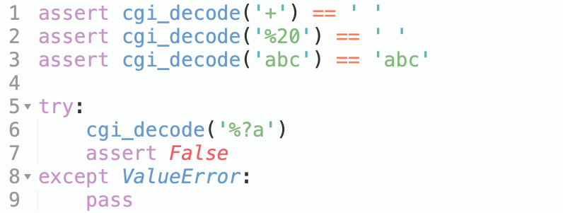
Code Coverage
Black-Box Testing
We can test the function cgi_decode() from the specification to these four features:
testing for correct replacement of '+’;
testing for correct replacement of "%xx";
testing for non-replacement of other characters; and
testing for recognition of illegal inputs.

Slide 52
Code Coverage
Black-Box Testing
Advantage:
finds errors in the specified behavior
independent from a given implementation
allows to create test even before implementation;
Downside:
implemented behavior typically covers more ground than specified behavior
typically do not cover all implementation details.

Slide 53
Code Coverage
White-Box Testing
We can derive tests from the implementation of the function cgi_decode(), White-Box testing is closely tied to the concept of covering structural features of the code.
It introduces a number of coverage criteria :
Statement coverage – each statement in the code must be executed by at least one test input
Branch coverage – each branch in the code must be taken by at least one
test input
Sequences of branches taken
Loop iterations taken
……

Slide 54
Code Coverage
White-Box Testing
Let us consider cgi_decode().
We’d have to cover：
The block following if c == ‘+’
The two blocks following if c == ‘%’
The final else case for all other characters

Slide 55
Code Coverage
White-Box Testing
Advantage:
finds errors in the implemented behavior
can be conducted even in cases where the specification does not provide sufficient details
can identifying corner cases in the specification
Downside:
may miss non-implemented behavior
If some specified functionality is missing, white-box testing will not find it.

Slide 56
Code Coverage
Tracing Executions
White-box testing allows for automatic assessment of program feature coverage by instrumenting the program's execution
This information can be used by the programmer to focus on writing tests that cover the remaining uncovered code.
In Python, the function sys.settrace(f) allows to:
define a tracing function f() that is called for each and every line executed
gets access to the current function and its name, current variable contents, and more
do dynamic analysis (the analysis of what actually happens during an execution)

Slide 57
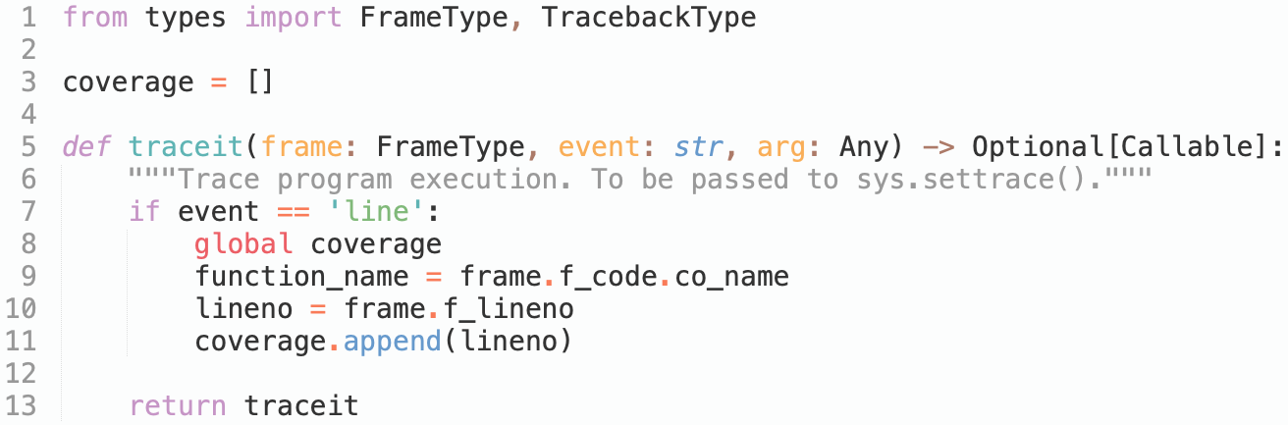
Code Coverage
f_code.co_name: current function name
f_lineno: current line number
f_locals: current local variables and arguments
Tracing Executions
"line" (a new line has been reached)
OR
"call" (a function is being called)
Store the tracing information

Slide 58
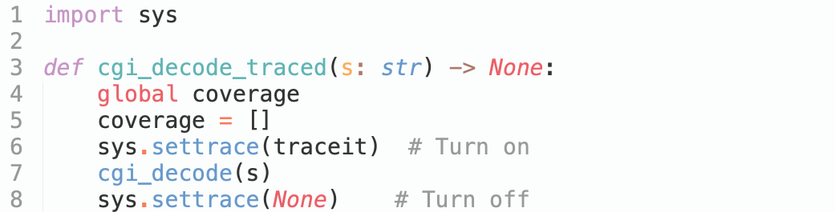
Code Coverage
Tracing Executions
switch tracing on and off
with sys.settrace()

Slide 59
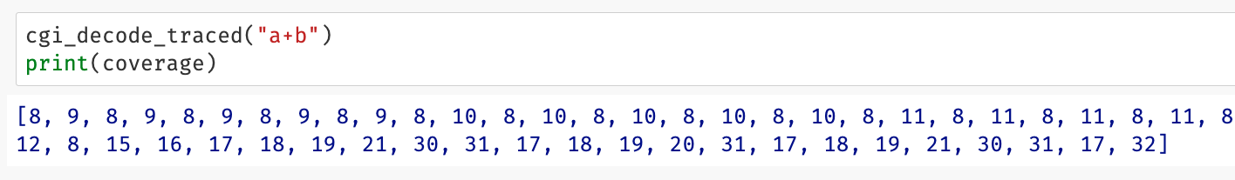
Code Coverage
Tracing Executions
switch tracing on and off
with sys.settrace()
line number only!

Slide 60
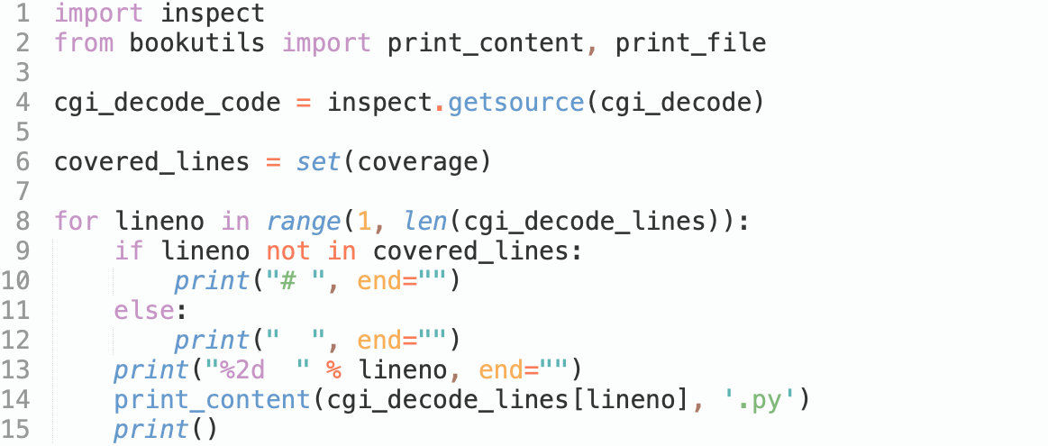
Code Coverage
Tracing Executions
get target function source code
deduplication of code line numbers
print the code coverage

Slide 61
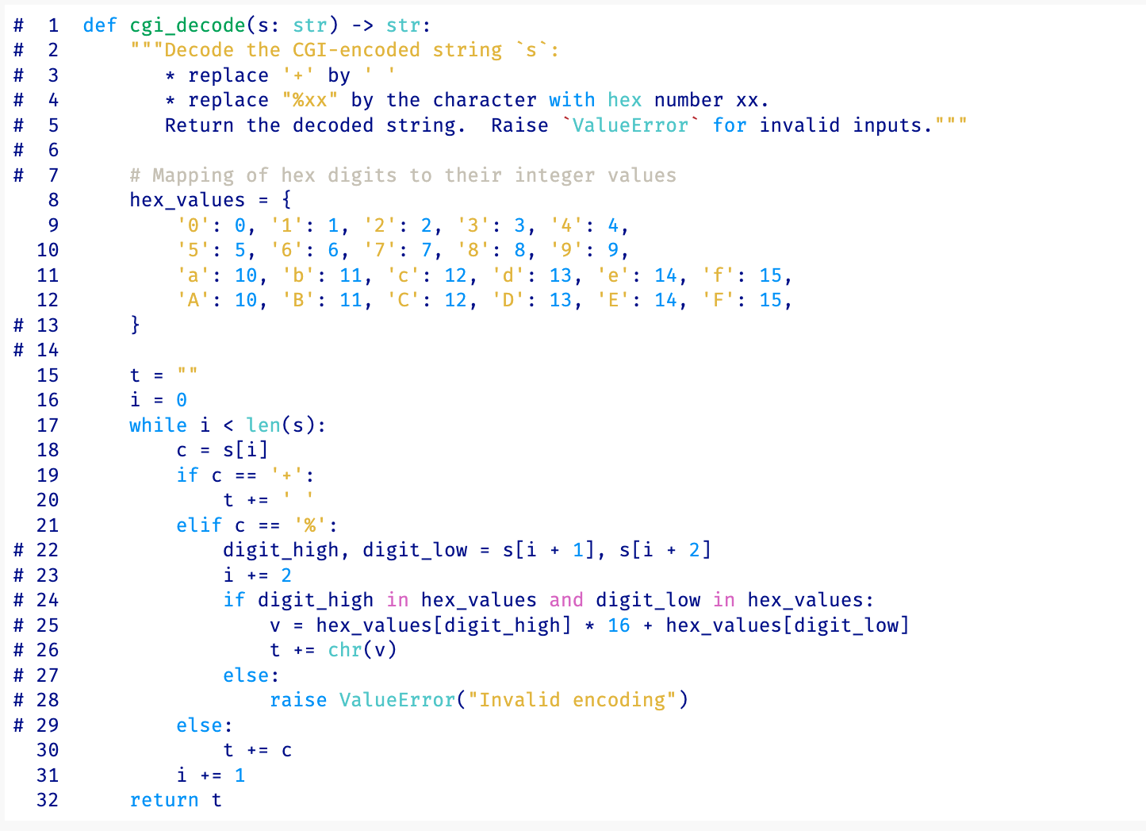
Code Coverage
Tracing Executions
Covered code with
input "a+b"

Slide 62
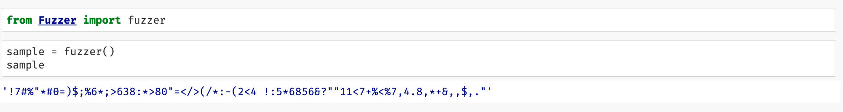
Code Coverage
Coverage of Basic Fuzzing

Slide 63
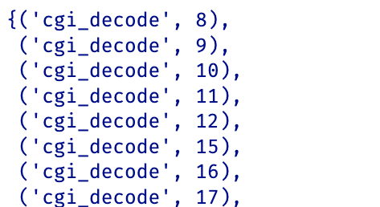
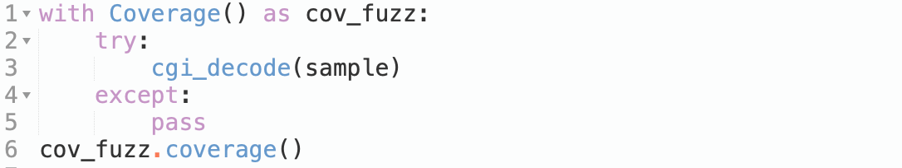
Code Coverage
Coverage of Basic Fuzzing

Slide 64
Code Coverage
Coverage of Basic Fuzzing

Slide 65
Code Coverage
Getting Coverage from External Programs

Slide 66
Code Coverage
Finding Errors with Basic Fuzzing

